Slide 1
HISTROIC FILM ARCHIVE SYSTEM PROJECT
Presented by:-
Group Name: Tech Brains
ANUJA SHIRAHATTI
H.SWATHI
C.NAYANA
ANUPAMA R.K

Slide 2
PROBLEM STATEMENT
HISTROIC FILM ARCHIVE SYSTEM
Historic Film Archive System POC:•
CRUD: Archive data.
catalog_historic_films(film_id): Catalog and manage historic films in a digital archive.
provide_access_to_researchers(access_id): Provide researchers access to film archives.

Slide 3
INTRODUCTION
The preservation of our cinematic heritage is not just about safeguarding reels of film; it's about preserving the stories, cultures, and moments that shape our collective memory. Historic film archive systems serve as the custodians of this invaluable legacy, meticulously cataloging, restoring, and making accessible the treasures of celluloid and digital frames that chronicle our past.
Beyond mere preservation, historic film archive systems are hubs of research and education, offering scholars, filmmakers, and enthusiasts a window into the past. They provide a vital resource for understanding the evolution of cinema as an art form, its impact on society, and role in shaping our collective consciousness.

Slide 4
REQUIREMENT ANALYSIS
Defining film_archive
Collecting Information about different historic movies
Identifying the users
Classifying the historic movies into different categories
Considering the movie Id, Title , Director name , generation
Evaluating the need for real-time updates and deleting the unwanted movies history.

Slide 5
METHODS
__ init __
Add _ film()
Update _ film ()
Delete _ film ()
self . get _ film _ details ()
Add researcher()
Archived movies()

Slide 6
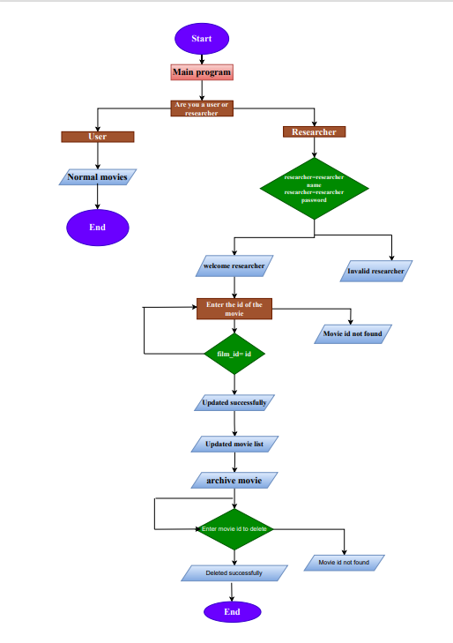
FLOWCHART

Slide 7
FUNCTIONS
class FilmArchive:
def __ init __(self):
self.film _records = []
self.researchers = []
def add_film(self, film):
self.film_records.append(film)
def delete_film(self, film_id):
for film in self.film_records:
if film.film_id == film_id:
self.film_records.remove(film)
break
else:
print(f"Film with ID {film_id} not found in the archive.")
class Film:
def __init__(self, film_id, title, director, release_year, archived=False):
self.film_id = film_id
self . title = title
self.director = director
self.release_year = release_year
self.archived = archived

Slide 8
def update_film(self, researcher, film_id, updated_data):
if researcher in self.researchers:
for film in self.film_records:
if film.film_id == film_id:
film.title = updated_data.title
film.director = updated_data.director
film.release_year = updated_data.release_year
film.archived = updated_data.archived
print("Film updated successfully!")
def add_researcher(self, researcher):
self.researchers.append(researcher)
def delete_researcher(self, researcher_id):
for researcher in self.researchers:
if researcher.id == researcher_id:
self.researchers.remove(researcher)
break
else:
print(f"Researcher with ID {researcher_id} not found.")

Slide 9
def get_normal_movies(self):
return [film for film in self.film_records if not film.archived]
def get_archived_movies(self):
return [film for film in self.film_records if film.archived]
def delete_film_by_researcher(self, researcher, film_id):
if researcher in self.researchers:
for film in self.film_records:
if film.film_id == film_id:
self.film_records.remove(film)
print(f"Film with ID {film_id} has been successfully deleted.")

Slide 10
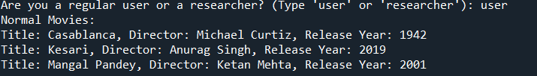
OUTPUT

Slide 11
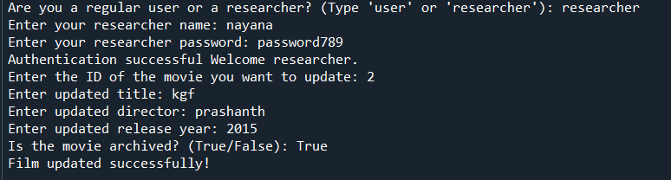
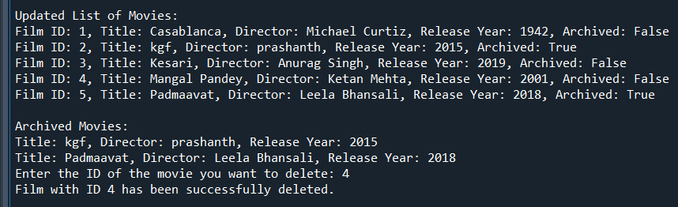
OUTPUT

Slide 12
CHALLENGES
Physical Preservation
Digital Preservation
Metadata Management
Funding and Resources

Slide 13
CONCLUSION
Moreover, these archives play a crucial role in ensuring the accessibility of cinematic heritage to future generations. Through digitization efforts and collaborative initiatives, they strive to make these treasures available to a global audience, transcending geographical boundaries and temporal constraints.
In essence, historic film archive systems are not just repositories of celluloid and pixels; they are living monuments to human creativity, resilience, and imagination. They remind us of the power of storytelling to transcend time and space, enriching our lives and connecting us to our shared human experience.

Slide 14
FUTURE SCOPE
Enhanced Interactivity: Develop interactive features such as virtual reality (VR) experiences, augmented reality (AR) overlays, or immersive storytelling techniques to engage users more deeply with the films and their historical contexts.
Collaborations and Partnerships: Forge partnerships with film archives, museums, educational institutions, and cultural organizations to expand the scope of the archive and access additional resources, expertise, and content.
3.Data Visualization and Analytics: Develop data visualization tools and analytics dashboards to uncover insights about film trends, historical patterns, audience preferences, and cultural influences. This could help researchers, educators, and filmmakers gain new perspectives on film history.
4.Mobile Applications and Social Integration: Create mobile applications that enable users to access the archive on-the-go and share their favorite films, reviews, and insights on social media platforms. Foster a vibrant online community of film enthusiasts.
By pursuing these future directions, the historic films archive project can continue to grow and evolve, serving as a valuable resource for film enthusiasts, scholars, educators, and cultural heritage institutions around the world.

Slide 15


